Slide 1

LOAN PREDICTION

Slide 2
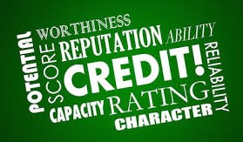


Slide 3
INTRODUCTION
A system called loan worthiness prediction system is such that it helps an organization in making right decisons to approve or reject the loan request of customers.
Enabling of the federated learning Algorithm for continuous flow of users data and learning.
This idea is meant to fill the common flaws of our common platforms form loan acquisition using federated learning.

Slide 4
AIM
To build a model that predicts a customer's credibility/worthiness for loan acquisition with little or no error.
PROBLEM STATEMENT
One of the major challlenges in the financial sector is being able to determine a customer's credibility for loan acquistion not just with the use of collarteral only. Hence a credible and more accurate method is required , this was the incentive for the idea. The system learns on the go and you don’t have to recreate or retrain the whole system all over again.

Slide 5
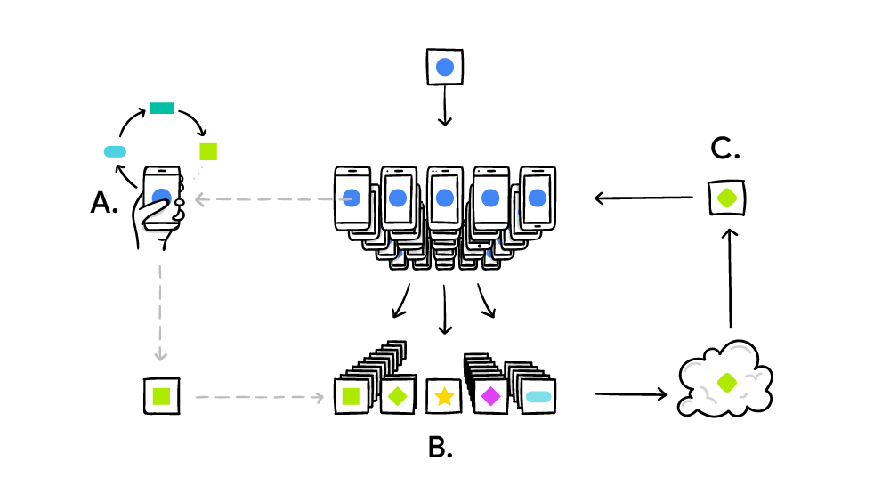
FEDERATED LEARNING

Slide 6
ARCHITECURE OF THE PROPOSED MODEL
INPUT CUSTOMER DETAILS
TEST SET
DATA PREPOCESSING
MODEL
TRAINING SET
LOGISTICS REGRESSION
ALGORITHM

Slide 7
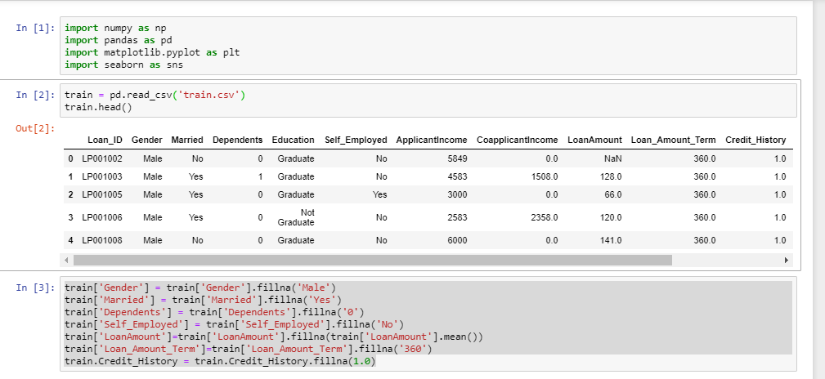
DATA OVERVIEW

Slide 8
ALGORITHM COMPARISON
MODELS | ACCURACY( %)
SVC | 0.829
KNN | 0.821
Logistic Regression | 0.837
Decision Tree | 0.699
Naive_Bayes | 0.829
Random Forest | 0.756

Slide 9
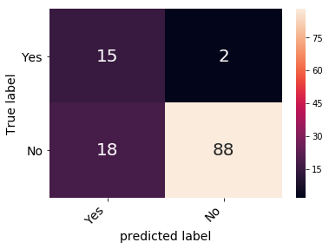

Slide 10
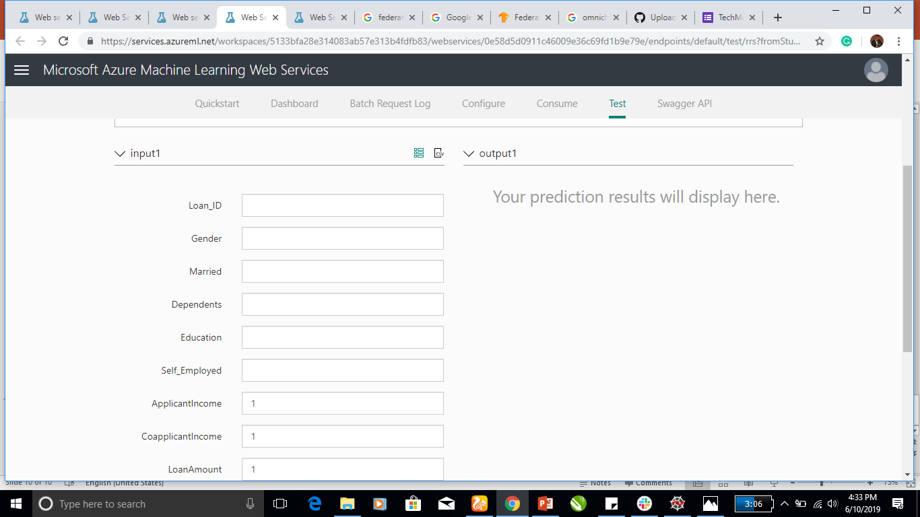
DEMO

Slide 11
CONCLUSION
Using logistic regression, with an accuracy of approximately 84%, the model proved to be the most optimal for predictive analysis but not to worry, the federated learning models allows for rapid learning process as the system is in use.

